Slide 1

Presented To
Mrs.Neema Jha
PRACTICAL SUBMISSION
MATHS AND STATISTICS FOR DATA SCIENCE
Presented By
Amit Kumar
(B.sc datas cience) sem -1
Presented To
MRS. DR.Aashima Bangia
(Assistant professor)

Slide 2

Content
Basic Fundamental Of Statistics
Introduction to Distribution
Mathematics For Confidence intervals
Introduction to Regression Analysis
Introduction to Probability

Slide 3

Introduction to statistics
Statistics is a branch of mathematics dealing with data collection and organization, analysis, interpretation and presentation.

Slide 4
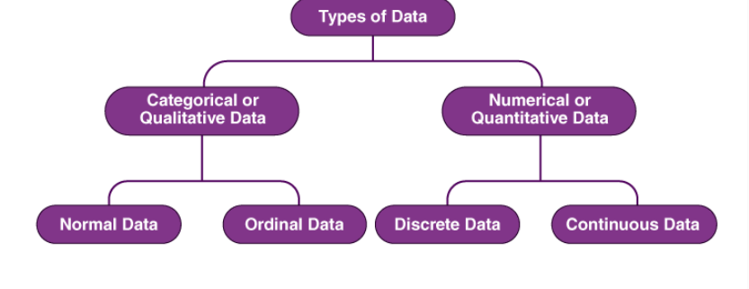


Qualitative or Categorical Data
Qualitative data, also known as the Categorical data, describes the data
that fits into categories. Qualitative data are not numerical. The categorical information involves variables that describe the features such as person’s gender, home town etc.

Slide 5

Quantitative or Numerical Data
Quantitative data is also known as numerical data which represents the numerical value(i.e.,how much, how many, how often). Numerical data gives information about the quantities of a specific thing.
Nominal Data
Nominal Data is the data it cannot be ordered and measured. Examples of nominal data are letters, symbols,words,gender etc.
Ordinal Data
Ordinal data / variable is a type of data that follows a natural order.

Slide 6

Continuous Data
Continuous data is data that can be calculated. It has an infinite number of probable values that can be selected within a given specific range
Example : Temperature range
Discrete Data
Discrete data can take only discrete values . Discrete information finite number of possible values.

Slide 7
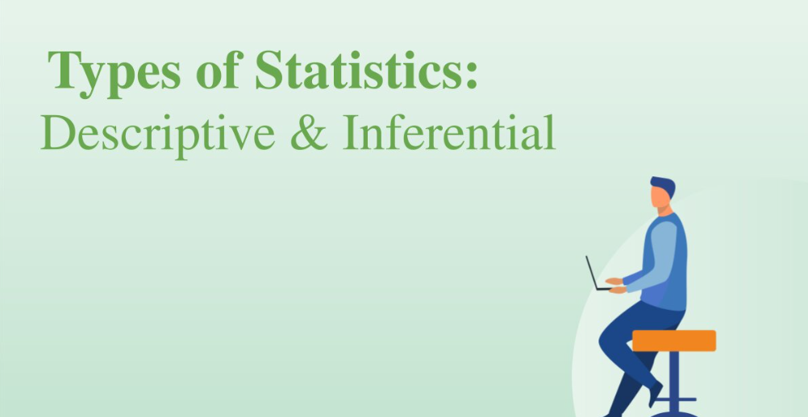
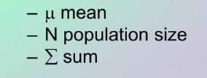
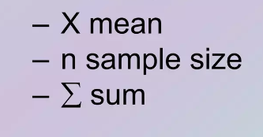
Descriptive statistics refers to those methods which are used for collection, presentation as well as analysis of data. These methods related to such estimations as ‘measurement of central tendencies’(Mean, Median, Mode), ‘measurement of dispersion’(Mean deviation , standard deviation.
Inferential statistics refers to all such as methods by which conclusions are drawn relating to the universe or population on the basis of a given sample.

Slide 8
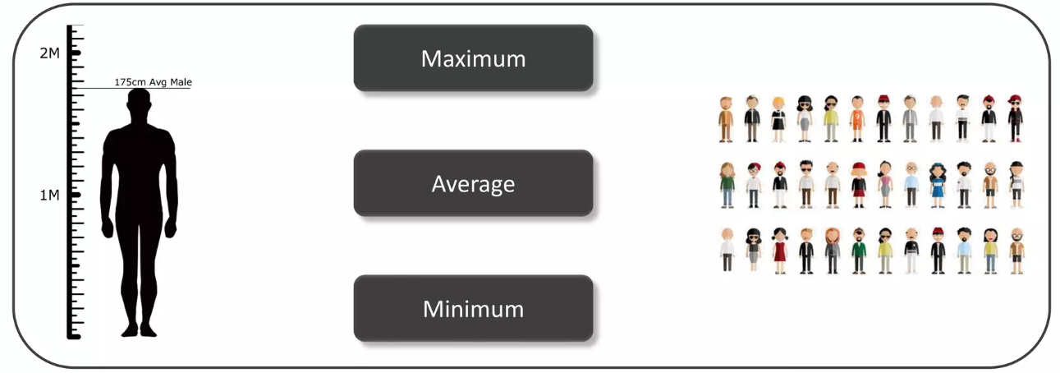
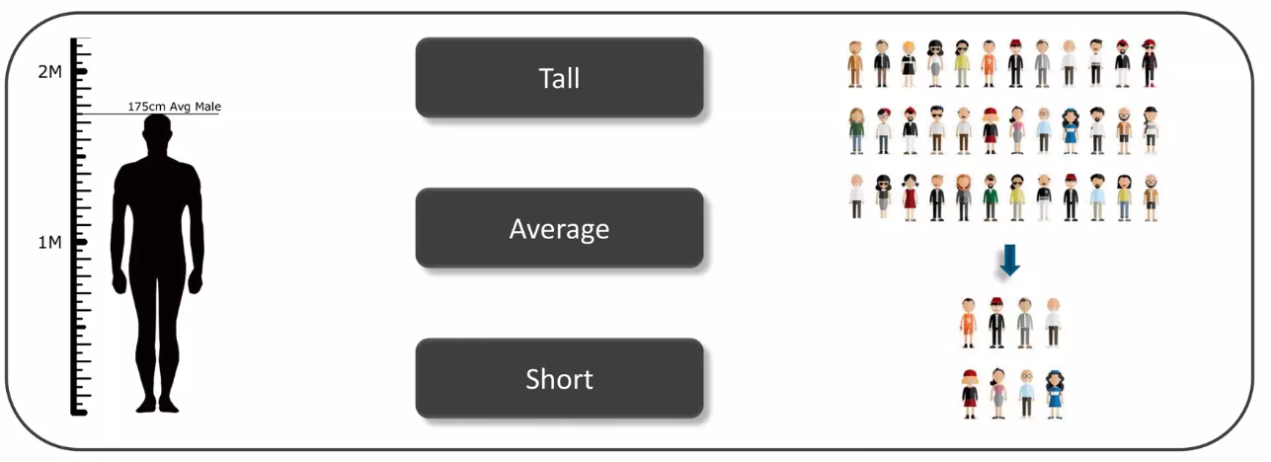

Slide 9
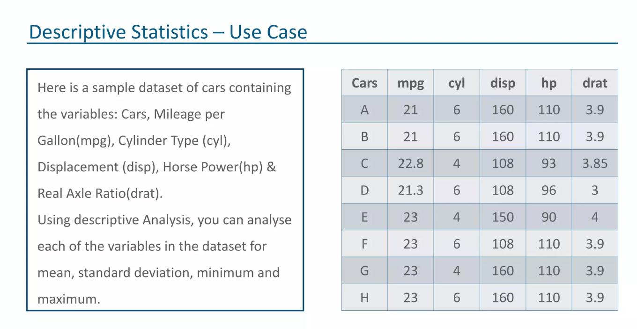
Measurement of central Value
Mean :- Average value of data, it is called mean.

Slide 10
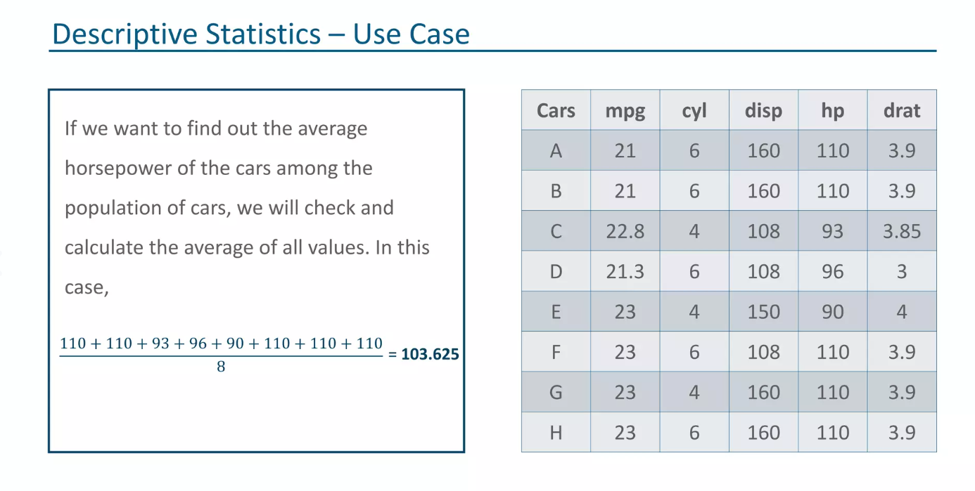

Slide 11
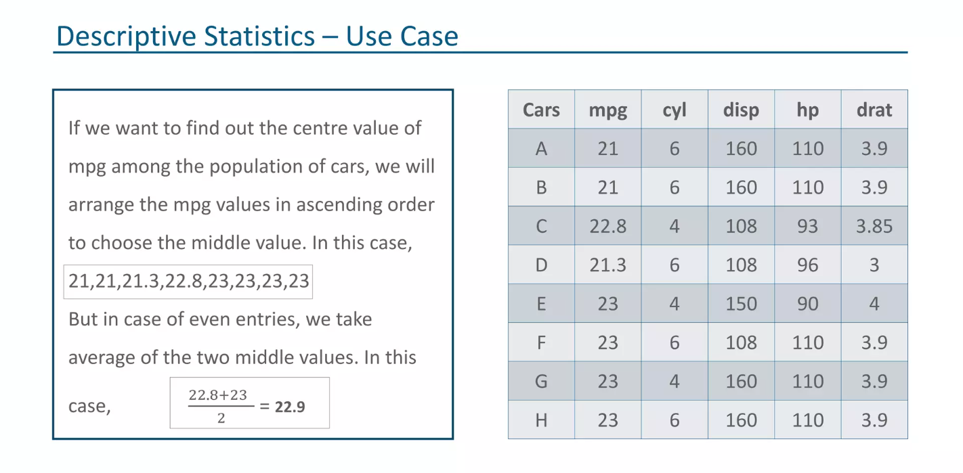
Median :- Middle value of ordered data It is called Median.

Slide 12
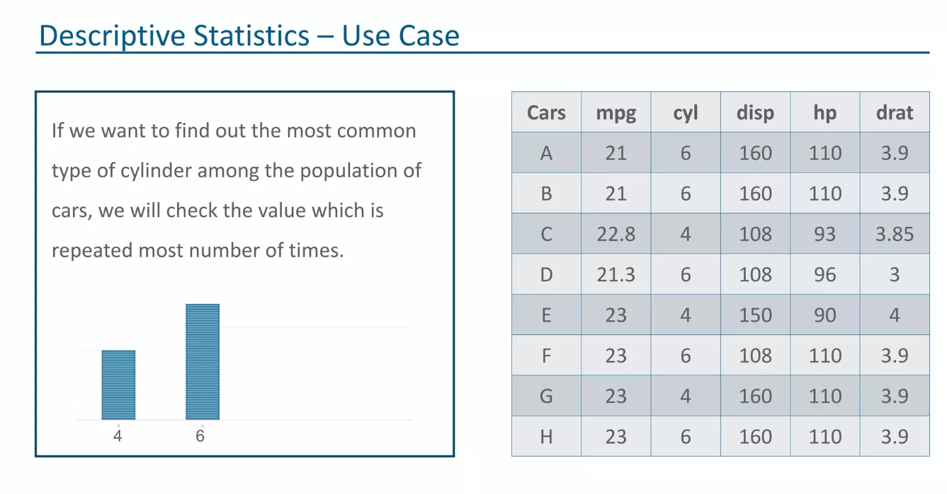
Mode : - most occurring data, suited for categorical data (nominal and ordinal data.)

Slide 13

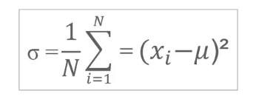
Measure of Spread/Dispersion
Deviation
Deviation is the difference between each element from the mean.
Varience
Variance describe how much a random variable differ from its expected value.
It entails computing squares of deviations.
Standard Deviation
Standard Deviation is the measure of the dispersion of a set form its mean.

Slide 14
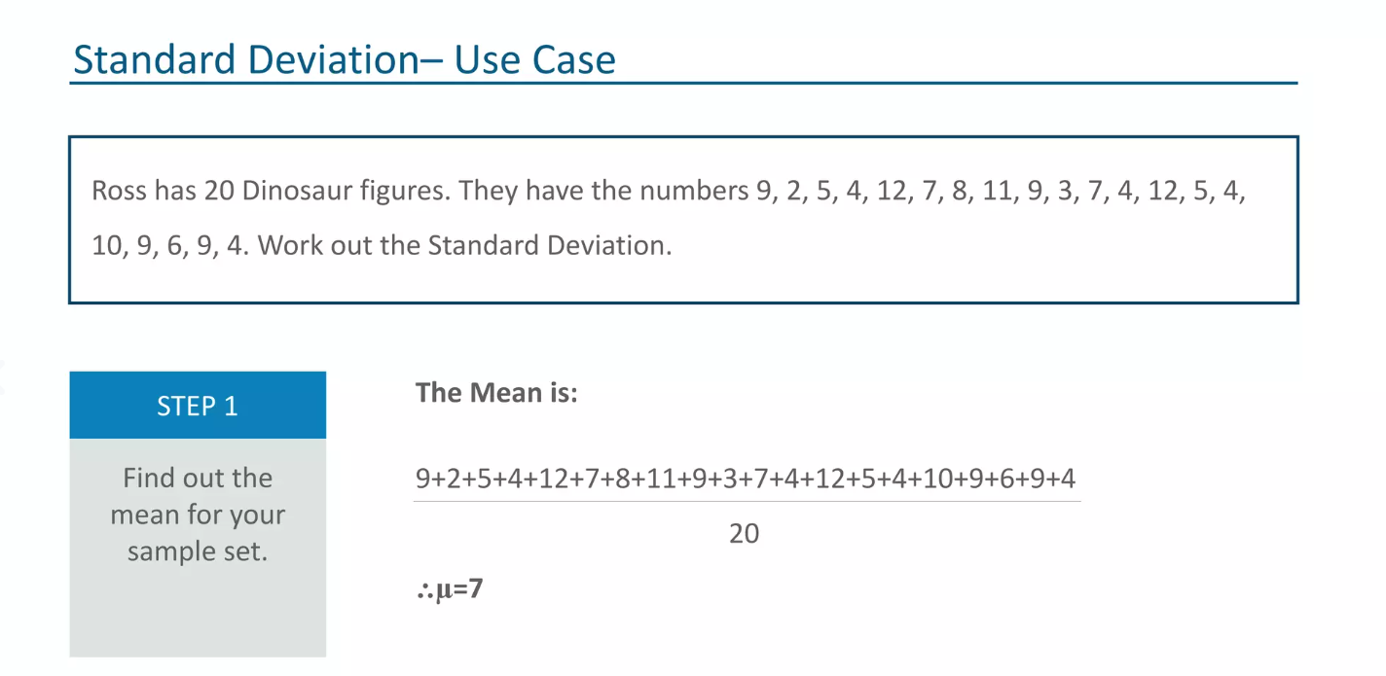

Slide 15
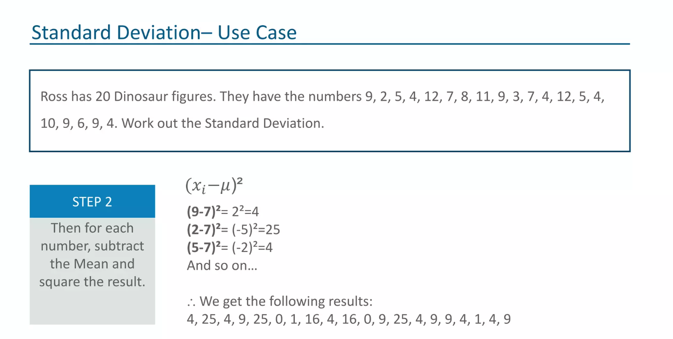

Slide 16
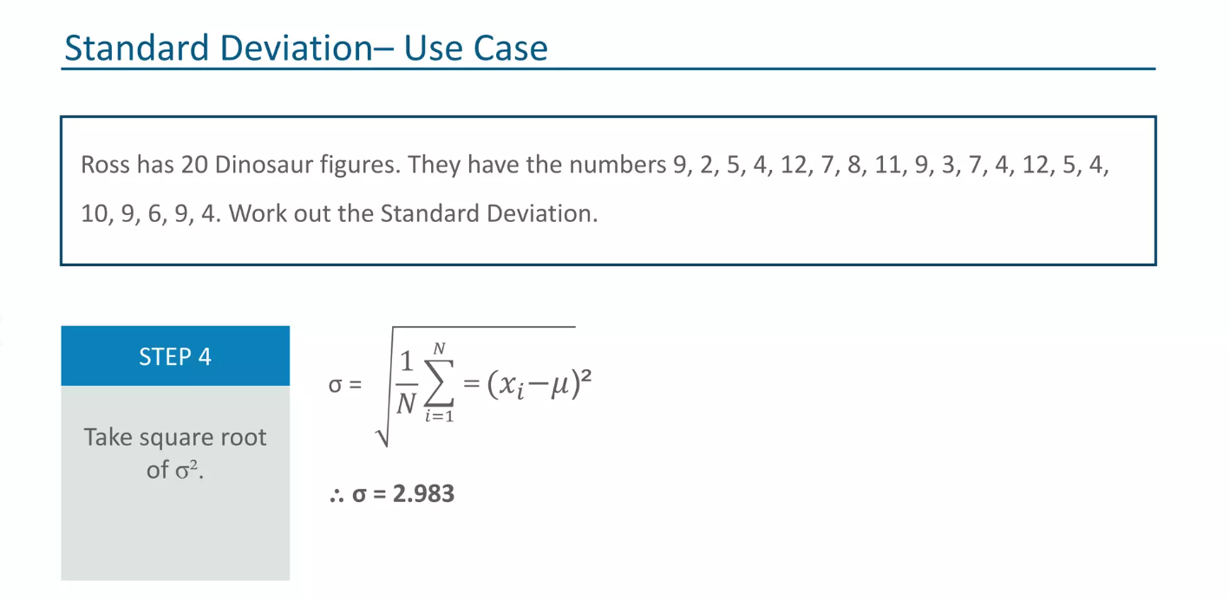

Slide 17
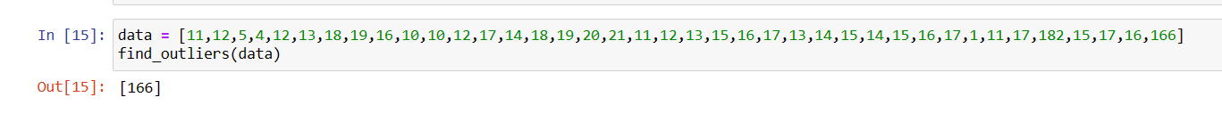
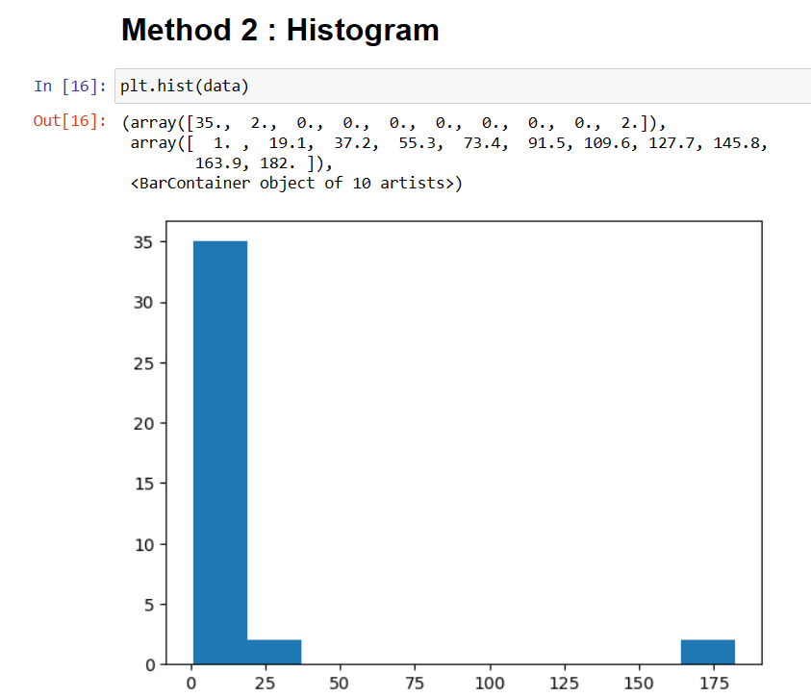
Box Plot

Slide 18
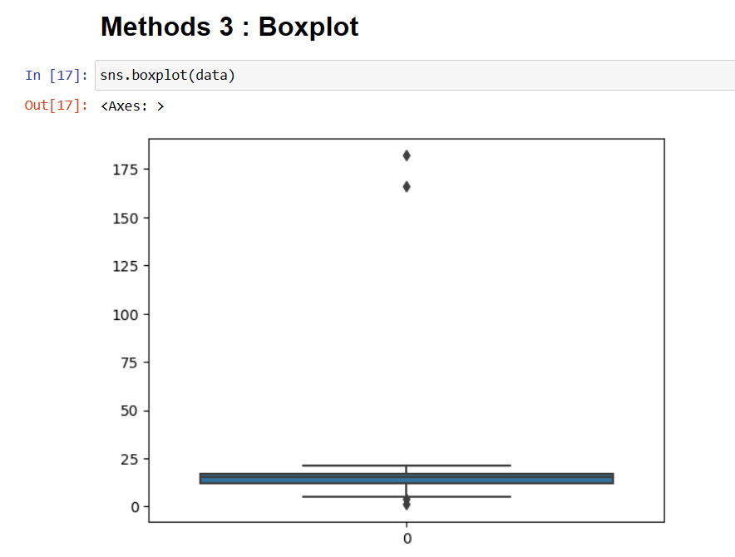

Slide 19
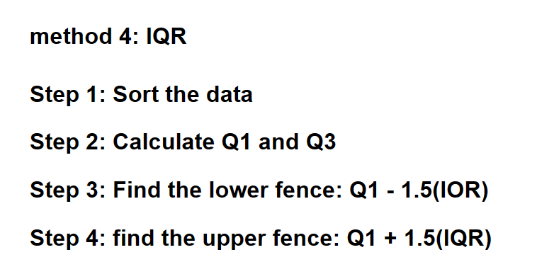

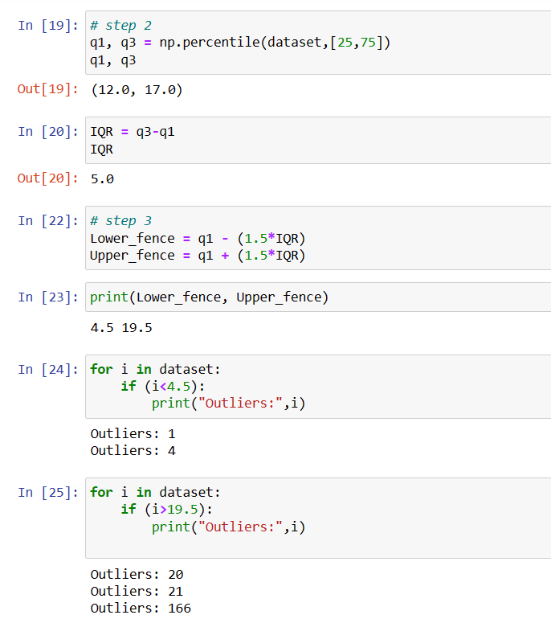

Slide 20
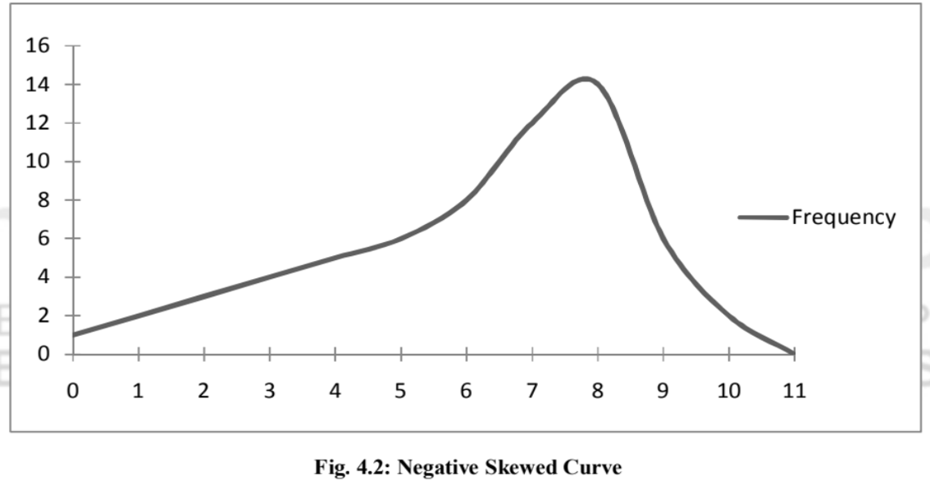
Skewness

Slide 21
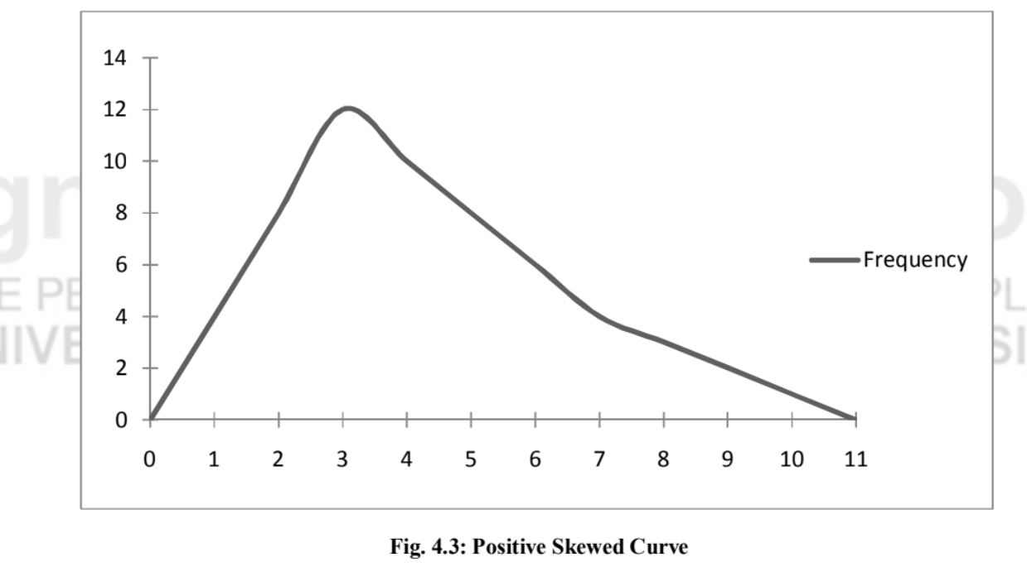

Slide 22
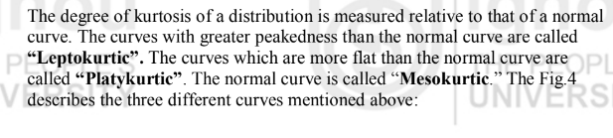
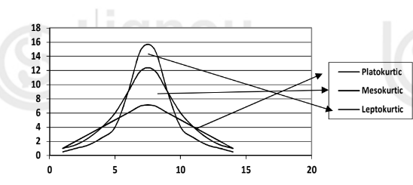
Kurtosis

Slide 23
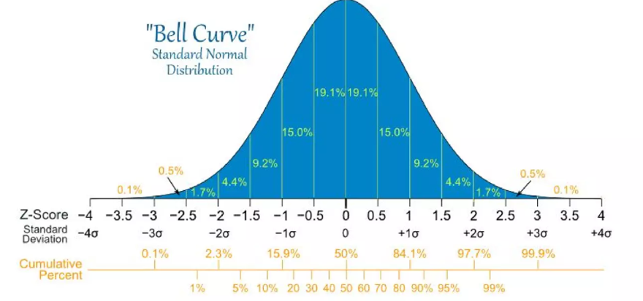
Introduction to distribution
The probability density function (pdf) of the normal distribution, also called Gaussian or “bell curve”, the most important continuous random distribution.

Slide 24
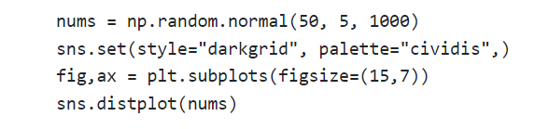
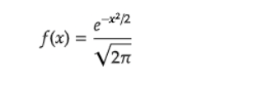
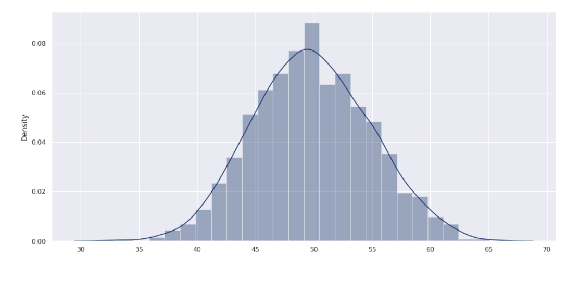
Formula Normal Distribution

Slide 25
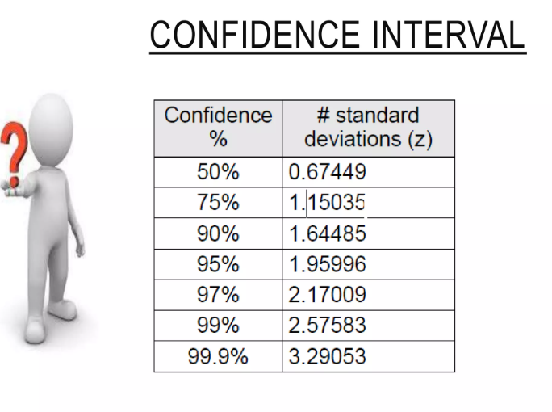
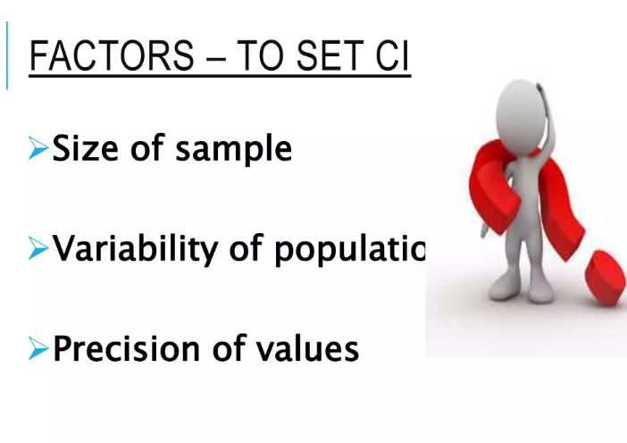
Introduction to confidence interval ?
A range of values so constructed that there is a specified probability of including the true value of a parameter within it .

Slide 26
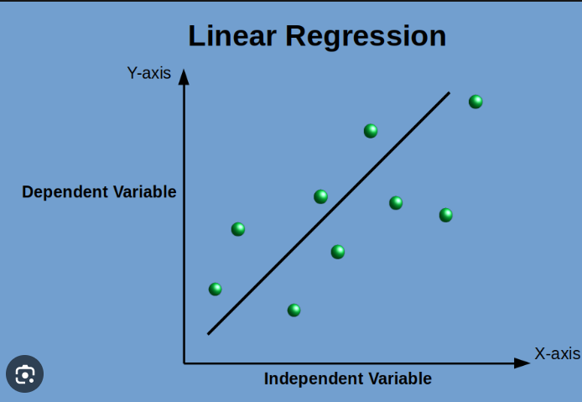
Introduction to Regression Analysis
Regression Analysis measure the nature and extent of the relationship between two or more variables, thus enables us to make predictions.
Regression is the measure of the average relationship between two or more variables.

Slide 27
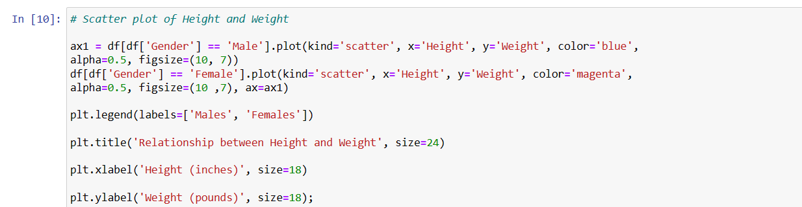

Slide 28
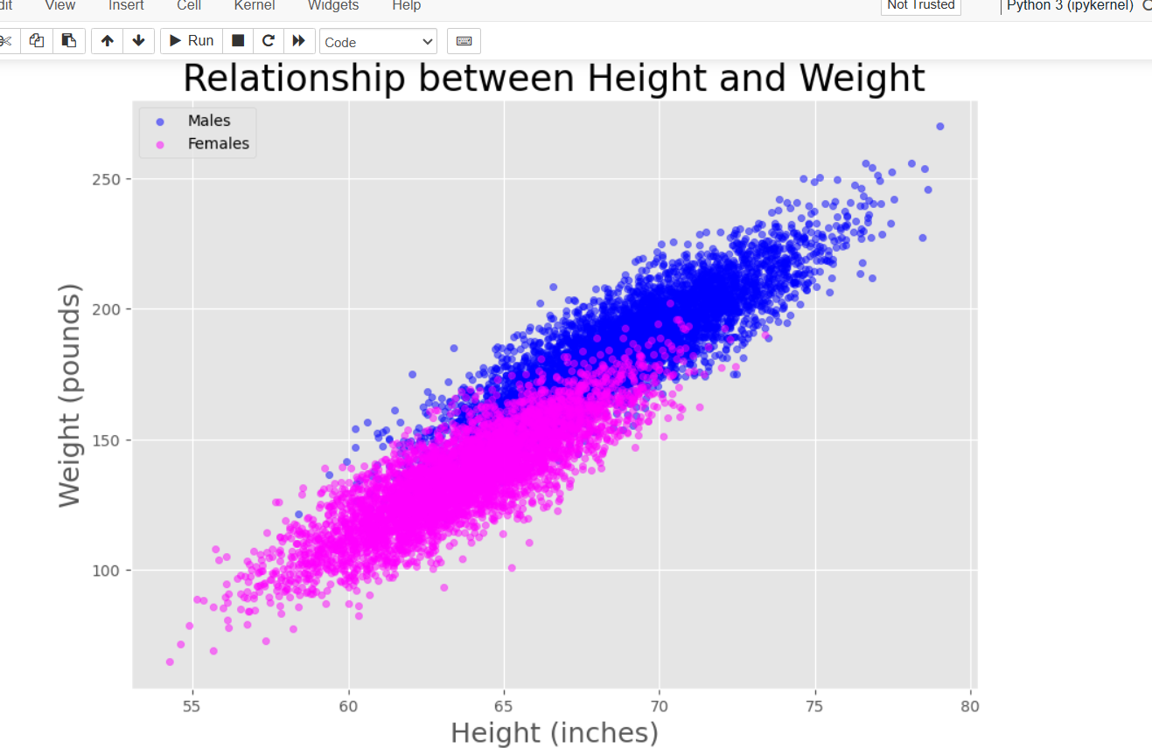

Slide 29
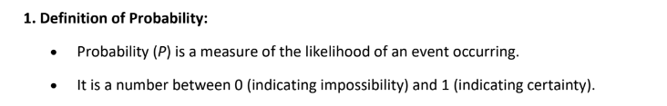





Slide 30
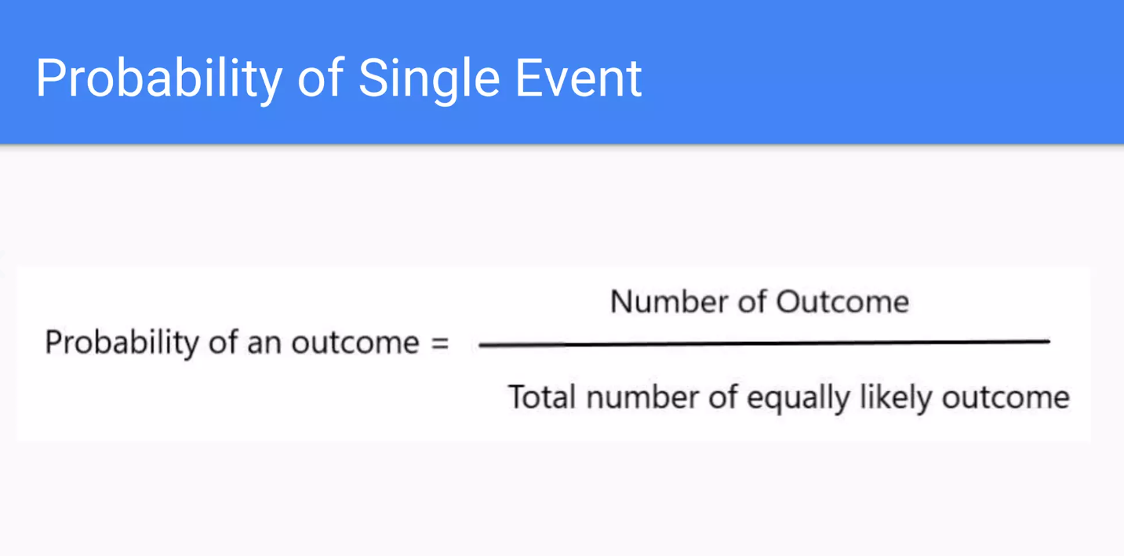
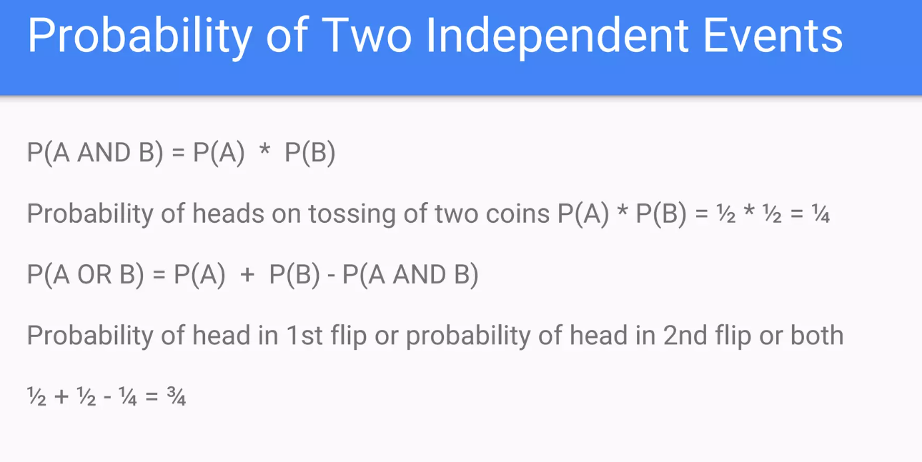
Probability formula :

Slide 31
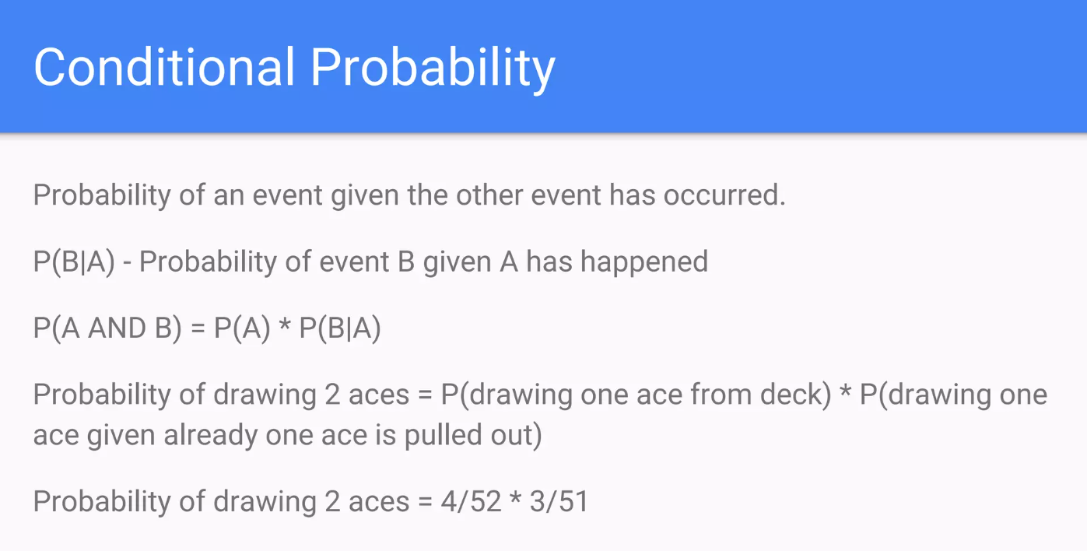

Slide 32


